Slide 1


Programming for Engineers
Lab class 6

Slide 2

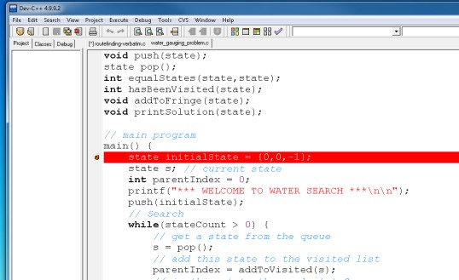
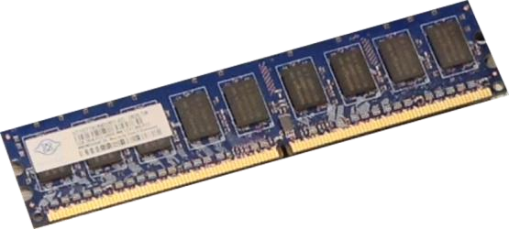
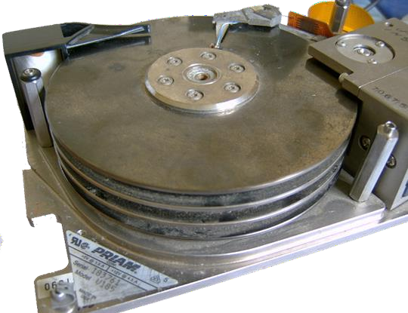
Previously
Debugger
Pointers & File I/O
RAM
01
02
. . .
F0
i = 10
k = 2
*p = 01
Problem-solving
fprintf fscanf
A3
 Search
 Queue ADT
A2
B3
A1
B2
C3
B1
C2
C1

Slide 3

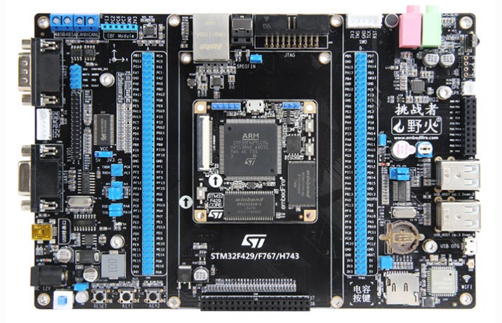
Today
From C to C++
 Object-orientation
 Classes and objects
Freedom platform
 ARM Cortex-M7 （STM32F767）
 Create a simple program

Slide 4

From C to C++
What is the difference?
 C++ syntax is largely similar to C
 However, C++ offers a range of extensions to C, most notably object-orientation
Object-orientation is a different programming paradigm that offers certain benefits over procedural programming

Slide 5


Object-Orientation
The object-oriented paradigm models the world as sets of objects that each have particular attributes and exhibit certain behaviour.
Example: A gift shop
class Product{ int price; char name[];
public:
void set_price(int);
};
class ShoppingBasket{ int itemCount; Product items[];
...
};
Landscapes Calendar
Product
is a
Cats Calendar
has
Calendar
is a
buys
is a
Customer
Price
goes into
is a
Shopping Basket
T-Shirt
Real-world
problem domain
Abstract
Conceptualisation
Computer
Model

Slide 6
Object-Orientation
The object-oriented paradigm models the world as sets of objects that each have particular attributes and exhibit certain behaviour.
Unfortunately, the terminology used by practitioners across different OO-languages can be confusing.
Here some terms and phrases you may come across:
Class Object Attributes
: “blueprint of an object”, “abstract object description”, “model”
: “model of a thing”, “instance of a class”, “instance”
: “data members”, “fields”, “data”, “variables”, “values”, “state” “member functions”, “methods”, “functions”, “procedures”, “routines”
Behaviour :

Slide 7

Objects and Classes
What is the difference between a class and an object?
 A class is an abstract description of an object – like a template or a blueprint.
 A class describes all objects that are “of the same kind” yet may differ across
specific instances.
 For example, we may have a class that describes a car in terms of the number of wheels, seats, windscreen, steering wheel, brand, colour, etc. that it has.
 Specific instances of “car” represent the different objects we can create using the class as a building plan, so there could be a red Ford and a blue Mercedes.

Slide 8
Objects and Classes
Anatomy of a class: Overview
Class
Data members
Each class has a number of members, i.e. the data that model the attributes (e.g., characteristics or properties) of the objects that will be created from this class.
Member functions
The class also has member functions to model its behaviour and to retrieve or modify its data. These can be fully specified functions written within the declaration space of a class or just function prototypes (to be specified later in the program).

Slide 9
Objects and Classes
Anatomy of a class: Overview
Class
Data members
class SomeClass {
access_modifier:
<data members>
access_modifier:
<member functions>
};
Member functions

Slide 10
Objects and Classes
Anatomy of a class: Overview
Class
class Person {
private:
char* name; int age;
public:
int getAge() { return age;
}
void setAge(int);
};
Data members
Member functions

Slide 11
Objects and Classes
Anatomy of a class: Members and Member functions
Customer
char* name; int age;
…
The choice of data variables reflects the characteristics of the object in the context of the problem that needs solving.
We can use the scope operator (::) to specify a member function of a class outside of its declaration space. For instance, here, to populate the member age with a value.
setAge(int); setName(char*);
…
Customer::setAge(int a) { age = a;
}

Slide 12
Objects and Classes
Example: We want to create many different stars to draw on screen.
How can we characterise a star shape in an abstract fashion?

Slide 13
Objects and Classes
Example: Star object
Class “Star”
Star
Instances of “Star” (Objects)
Color col Position pos; int points; int size;
Abstraction
getColour() setColor(int) getPosition() setPosition(int,int); getPoints(); setPoints(int)
A class is an abstract description of an object and its behaviour.

Slide 14
Objects and Classes
Example: Star object
Class “Star”
Star
Instances of “Star” (Objects)
Color col Position pos; int points; int size;
Instantiation
getColour() setColor(int) getPosition() setPosition(int,int); getPoints(); setPoints(int)
An object is a concrete instance of a class.

Slide 15
Objects and Classes
Example: Star object
Class “Star”
redStar
Instances of “Star” (Objects)
Color: RED
Position: x=75, y=100 points = 5
size = 3
Instantiation
Star redStar; redStar.setColor(RED); redStar.setPoints(5);
…
getColour() setColor(int) getPosition() setPosition(int,int); getPoints(); setPoints(int)
Once instantiated, each object maintains it’s
own set of characteristics (Object state).

Slide 16
Objects and Classes
Object state
Once instantiated, each object has a state of its own.
The state of an object is determined by its data, i.e. the current values of its members.
redStar
yellowStar
greenStar
Color: RED
Position x=75, y=100
points = 5
size = 3
Color: YELLOW Position x=150, y=100 points = 4
size = 2
Color: GREEN Position x=225, y=100 points = 7
size = 5

Slide 17
Objects and Classes
Constructor
Most classes have at least one special function that is called whenever a new object of this class is created. This function is also called the Constructor of the class.
The constructor defines the initial values of essential data fields, i.e. sets the initial state of an object. A constructor tends to always have the same name as the class itself.
class Star {
<members>
public:
Star (int, int, Color); // points, size, color
<other member functions
Access modifier
};
Constructor name is the same as the class name

Slide 18
Objects and Classes
Multiple constructors and how to create an object
class Star {
private:
Color col;
<other members>
public:
Star () {}
Star (int x, int y, Color c) { setColor(c);
...
}
setColor(Color c) { col = c;
}
<other member functions>
};
main() {
Star greenStar; greenStar.setColour(GREEN); Star redStar(5,3,RED);
}

Slide 19

Good to know
Namespaces in C++
 Certain libraries may use identifiers of the same name
 Namespaces help tell them apart
 We either prefix an identifier with the library name,
or include the statement “using namespace <ns>” once
#include <string> using namespace std;
...
string s = "Hi!";
cout << s;
...
#include <string>
...
std::string s = "Hi!";
std::cout << s;
...

Slide 20

Useful object: Strings
std::string
 This is a proper string object
 Has its own methods, such as size()
 For input/output, we must use cin / cout instead of
scan / printf
(requires including the iostream library)
#include <iostream> #include <string>
...
string s = "Hi!";
...
cout << s;

Slide 21

Practice time
Creating classes and objects
Write a simple program that has a class “Person”, to be used in the context of
managing users of a public library.
(Save your program as a *.cpp file to make sure the C++ compiler is invoked)
Define suitable members for this class – what are attributes of a person?
Define member functions that implement what a person can do in a library
Create different “person” objects and let them do things – use the debugger to observe how each object maintains its own state.

Slide 22
STM32F767
Computing platform
 ARM® Cortex™-M7 (32-bit),216 MHz
 128MB flash， 32MB SDRAM
 Ethernet port
 Micro-USB (2x)
 LCD： 5-Inch touch screen
 LED：RGB
 WIFI
 Bluetooth HC05
And much more…

Slide 23

Preparation
Unpack the kit
 Open the box and take out
 board
 Application shield
 USB cable
 Carefully remove all items from their packaging
(Make sure not to damage anything that sticks out from the boards)

Slide 24
Practice time
Have a first play with the platform
 Familiarise yourselves with the Keil IDE
 Import and run the clock display example
 Inspect the code and try to figure what each element does

Slide 25

Next Lab
 More basics of object-orientation:
Abstraction and Modularisation
 Basic techniques for program design

